Slide 1

Digital environments
Lesson 5 – Communication over networks
Activity sheet
Selecting hardware for a network
Introduction
During this activity, you will be given several scenarios describing differing network needs. You should decide which hardware is required and complete the diagrams by selecting the missing hardware components. You can find the hardware components and descriptions on the next page.
If you are using this activity sheet electronically, copy and paste the relevant hardware components into the boxes provided. If you are completing this activity sheet on paper, write the name of the hardware component in the box.
Example
WAP
Version 1, June 2024

Slide 2
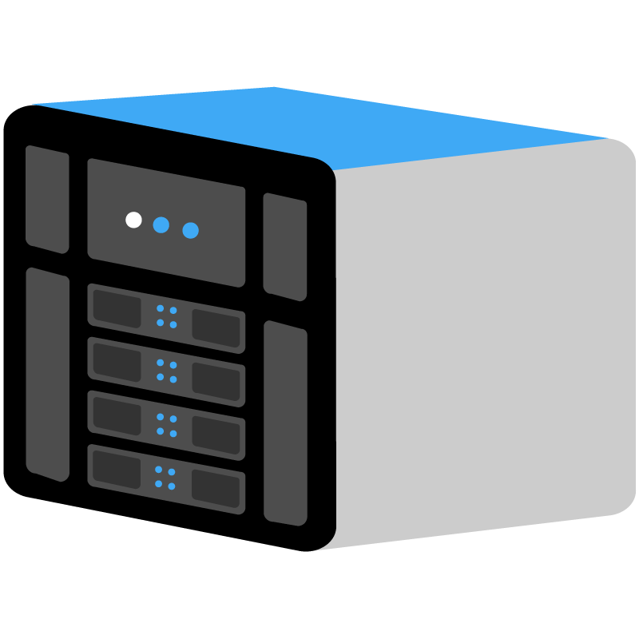
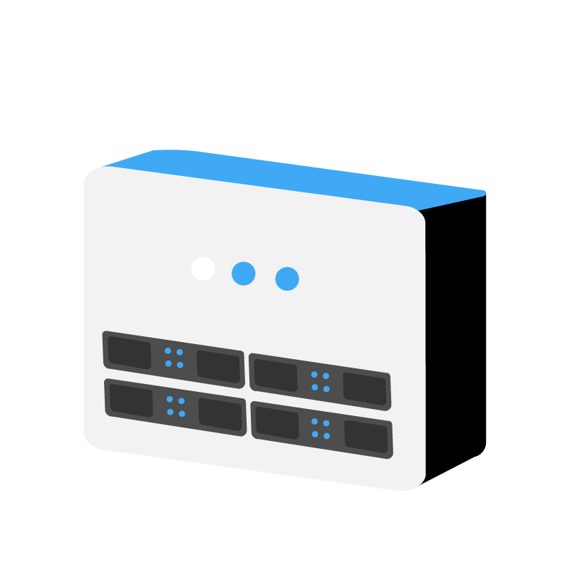
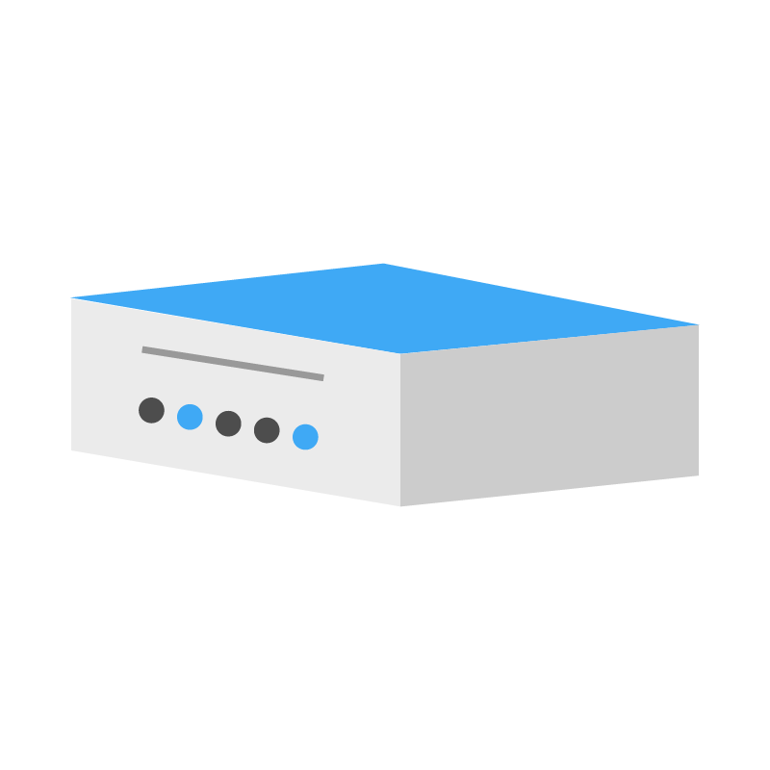
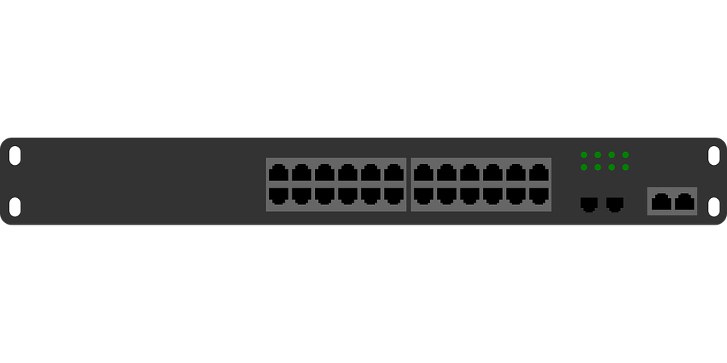
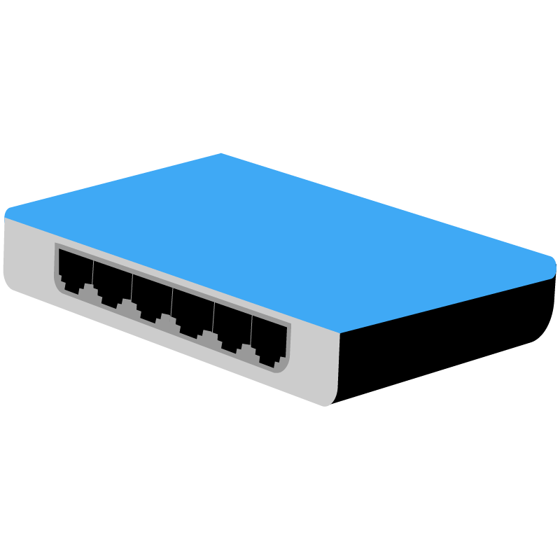

 | Digital environments Lesson 5 – Communication over networks Activity sheet
Network hardware components
 | Server A centralised device that manages access to resources across a network. The server fulfils requests from the clients on the network.
 | Hub A hub can be used to connect multiple wired devices together. A hub will receive any incoming data and broadcast (copy and transmit) it to all other devices connected to the hub.
 | Wireless access point (WAP) A wireless access point (WAP) provides a central point for wireless devices to connect to. The WAP allows wireless access to the network.
 | Router Responsible for moving data from one network to another. It is required to connect a local area network to the internet (which is also a network).
 | Bridge A bridge is used to connect a network segment to another network segment.
 | Switch A switch can be used to connect multiple wired devices together. A switch will receive any incoming data and transmit it to the specific device to which it is addressed.
 | Network interface card (NIC) A network interface card (NIC) allows a device to connect to a network. It is used to receive data from the network and to transmit data onto the network.

Slide 3


 | Digital environments Lesson 5 – Communication over networks Activity sheet
Scenario 1
An apprentice wants to test their networking skills and set up a wired network using three devices. They have a laptop and two PCs that they want to connect together. Each device already has a standard network interface card. The network will not be connected to the internet. Label the network hardware component that you think is missing from the diagram.
Switch
Network hardware
NIC
Bridge
Router
WAP
Hub
Server

Slide 4

 | Digital environments Lesson 5 – Communication over networks Activity sheet
Scenario 2
Internet
A wireless network has been set up. Currently, the laptops on the network can connect wirelessly, but they do not have a way to access the internet. Label the network hardware component that you think is missing from the diagram.
Router
Network hardware
NIC
Switch
Bridge
WAP
Hub
Server

Slide 5
 | Digital environments Lesson 5 – Communication over networks Activity sheet
Scenario 3
Internet
A network of four PCs is required for a small office of a media production company. The network will use wired connections as lots of large video files are shared regularly. The company also requires internet access. Label the network hardware components that you think are missing from the diagram.
Network hardware
NIC
Switch
Bridge
Router
WAP
Hub
Server

Slide 6

 | Digital environments Lesson 5 – Communication over networks Activity sheet
Scenario 4
A doctor’s surgery has been using a wired network for many years. They now want to add in wireless capabilities to allow doctors to use tablets whilst working in different parts of the building. Label the network hardware component that you think is missing from the diagram.
Network hardware
NIC
Switch
Bridge
Router
WAP
Hub
Server

Slide 7
 | Digital environments Lesson 5 – Communication over networks Activity sheet
Internet
Explorer task
Create a network for an office that requires wired and wireless connectivity. It also requires access to the internet. The company has four laptops and two tablets. The company wants to share software and files using a file server.
Network hardware
NIC
Switch
Bridge
Router
WAP
Hub
Server

